Slide 1

E-Retail Factors for Customer Activation and Retention
Project for Flip Robo Technologies

Slide 2
E-Retailing is the process of selling products or services to consumers for non- business use. It is a B2c(Business to Customers)business model that executes a transaction between businessman and final customer
Product satisfaction and value satisfaction is essential.

Slide 3
Computer Hardware and Softwear
Consumer Electronics
Books and music
Sporting and Goods
Office supplies
Toys,Health and Beauty
Apparel and clothing
Jewelry,
Cars
Services
Others
Products can be sell through E-Retailing

Slide 4
Important for customer activation
Attention – Grab the Visitor’s Attention
Interest – Pique their Interest in your product or site
Desire – Build Desire for the product
Action – Get them to follow a call to action

Slide 5
Marketing Mix for e-retailing
1
Convenience to the Customer(Place)
Customer Value and Benefits(Products)
Cost to Customer(Price)
Communication(Promotion)
2
3
4

Slide 6
Successful
Amazon – www.amazon.com – Books
Dell – www.dell.com - Computer Hardware
Marks and Spencer –www.marksandspencer.com
-- Clothing and gifts.
Boots – www.wellbeing.com – High Street Boots
E-Retailers across the world

Slide 7
Why Customer Retention is Key to Our Business?
Lower Marketing Costs
2. Repeat Purchase means repeat Profit
3. Word – of – Mouth Advertising
4. Gain Valuable Feedback
5. Sell at Premium Prices

Slide 8
Five Major Factors that contributed for the success of a e-commerce store
Trust
Service Quality
System Quality
Net Benefit
Information Quality

Slide 9
Customer Retention Strategies to grow Sales
Customer Retention
Create Customer Communities
Leverage Analytics to monitor customer Journeys
Measure Customer Life-time Value
Improve Customer Experience across all channels

Slide 10
Tips for Improving Retention Rate
Focus on acquiring high- value customers
Retarget one-time buyers at the right time to encourage a second sale
Send surveys to learn more about your customers for improved personlization
Track customer retention metrics and early indicators of churn
Improve customer loyalty and retention with software like a Customer Data Platform

Slide 11
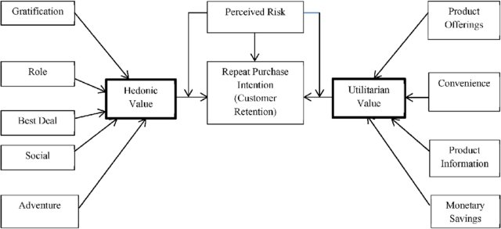
Complete Customer Retention Cycle as fallows:-

Slide 12


